Slide 1

Customer Value Analysis
Final Project - R
Abir Chatterjee
August
2020

Slide 2

Objective
We are given with an Insurance premium company data and we are intended to frame a regression model that can give us a regressed prediction of the Customer Lifetime Value (CLV) which happens to be our targeted/dependent variable in model so that we are able to predict which of the customers are the most profitable ones for the company.
Given this objective, we run a Linear Regression Model on our dependent variable CLV, to understand the influence the exogenously given variables have on our targeted variable.

Slide 3

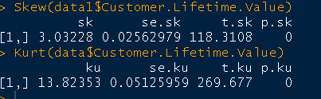
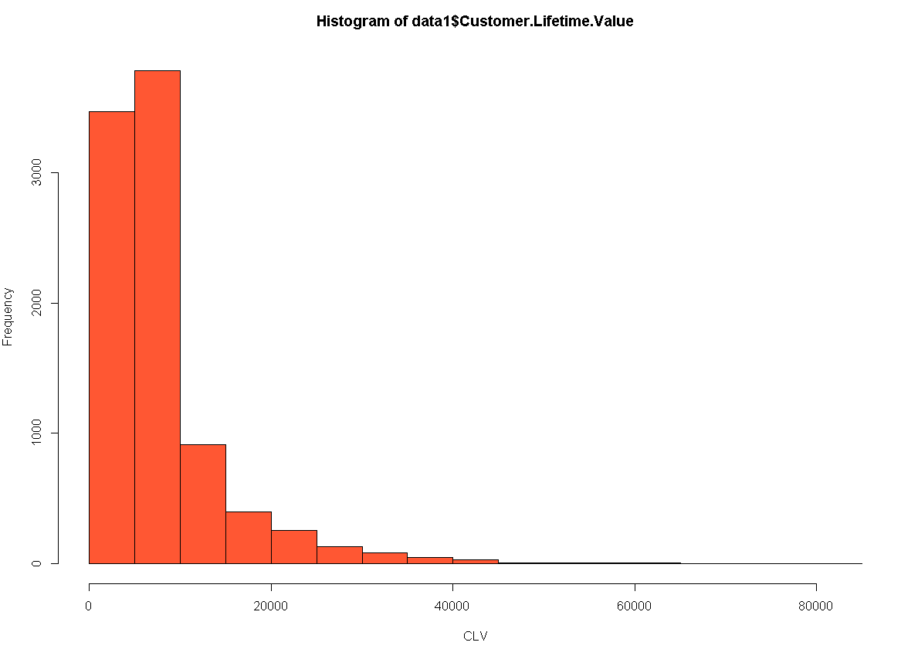
Dependent Variable
Our dependent variable is Customer Lifetime Value
Customer Lifetime Value (CLV), represents the total amount of money a customer is expected to spend in business, or on products, during their lifetime.
This is an important figure to know because it helps company to make decisions about how much money to invest in acquiring new customers and retaining existing ones.
From basic exploration, we get to see that clv is positively skewed meaning most data are concentrated on the left.
Kurtosis > 3, means distribution has thicker tails than normal distribution and there's presence of outliers (extreme values). Hence, it is Leptokurtic.
There are a lot of customers with a low CLV.

Slide 4

Count of Variables and Observations
Total number of variables : 22
They can be divided into Categorical Variables and Continuous Variables.
Categorical Variables are : State, Response, Coverage, Education, Effective to Date, Employment Status, Gender, Location Code, Marital Status, No. of Open Complaints, No. of Policies, Policy Type, Policy, Renew Offer Type, Sales Channel, Vehicle Class and Vehicle Size.
Continuous Variables include : Income, Monthly Premium Auto, Months Since last Claim, Months Since Policy inception and Total Claim Amount.
Total number of Observations are : 9134

Slide 5
Understanding the Variables
Below we mention all the statistically significant and insignificant variables that we’ve achieved after repeated iterations of the train data and putting them inn line with the test data.
Significant Variables
Insignificant Variables
Coverage
Education ( only College, Doctor and Master)
Employment Status ( Employed, Unemployed)
Income
Marital Status ( Single)
Monthly Premium Auto
Number of Open Complaints (3, 4, 5)
Number of Policies
Vehicle Class ( Sports Car, SUV)
State
Response
Effective to Date
Gender
Location Code
Month Since Last Claim
Month Since Policy Inception
Policy Type
Policy
Renew Offer Type
Sales Channel
Total Claim Amount
Vehicle Size

Slide 6

Explanation of Significant Variables
We try to understand the significant variables we have at hand , and give a detailed explain of them in relation to the influence they have on our targeted variable.
In Order to do so, we perform initial investigations on insurance data so as to discover patterns and to check assumptions with the help of summary statistics and graphical representations.

Slide 7
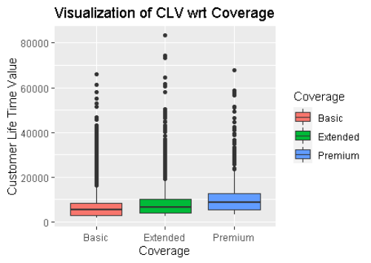
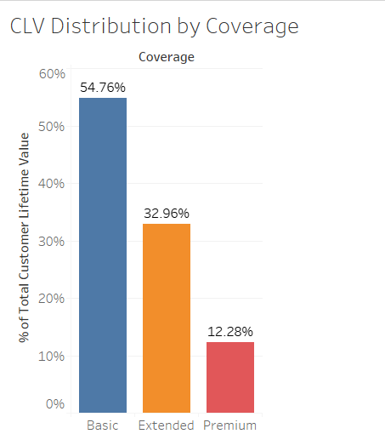
Coverage
Coverage basically refers to the kind of option/fund taken by the Customers.
It is the amount of protection given by an insurance policy.
They are divided into Basic, Extended and Premium packages
The top right diagram is the boxplot that visualizes the Customer Lifetime Value with respect to Coverage held by the policyholders.
The bottom right diagram shows the total distribution that CLV has on each Coverages.
From the boxplot it is conclusive that outliers do exist.
The Bar Graph shows us that customers who have taken Basic Insurance for their vehicles are more valuable then Extended or Premium Insurance Policy holders.

Slide 8
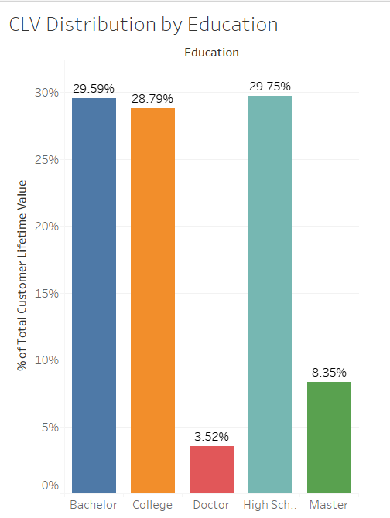
Education
Education refers to the academic qualifications of company's policyholders.
They are segregated into Bachelor, College, Doctor, High School and Masters.
We visualize with the help of a Bar Graph to understand the CLV distribution by Education.
We find that educated customers, below the age of 21 ( bachelors, high school goers and college students are mostly below 21 years of age) are the most valuable for the company.

Slide 9
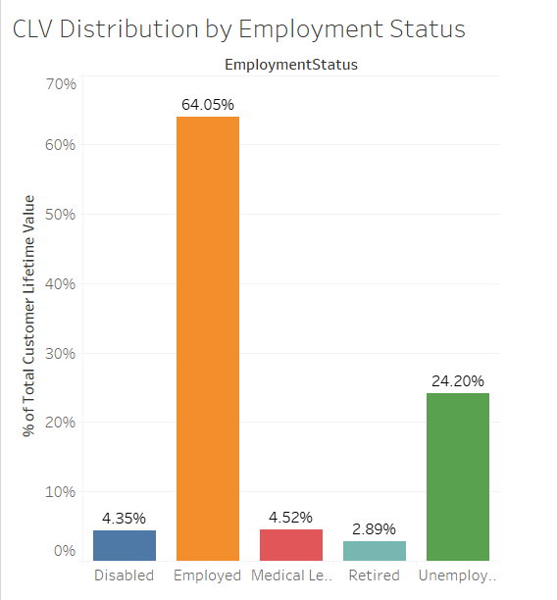
Employment Status
Employment status is a variable to take note of the current employment position of policyholders.
They have been divided into 4 cases: Disabled, Employed, Medical leave, Retired, Unemployed.
To have a graphic understanding of the data, we us a Bar Graph.
The figure shows us the CLV distribution with respect to the Employment Status category
As showed, Employed customers are more valuable than others as compared to Retired, Unemployed or Disabled Customers.
This makes sense as company will always prefer customers having a stable occupation.

Slide 10


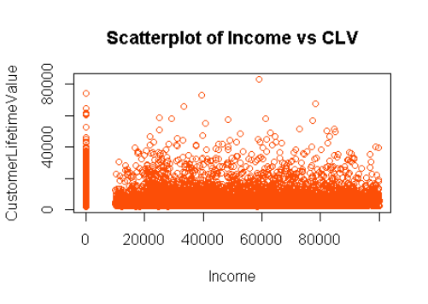
Income
Income variable store the earning of the policyholders.
To analyze, we try to find the scatter diagram of income with respect to CLV.
We also find the correlation income has with CLV.
Income has a positive, but close to zero correlation with CLV.
This shows that there is no strong relationship of Income with CLV.
This is further understood by looking at the scatter plot.
Also, the average income of policyholders is around 38K, although, we do have presence of extreme values.

Slide 11
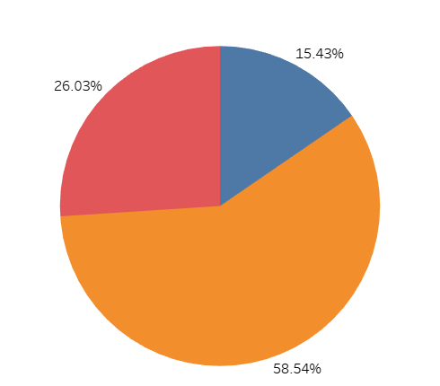
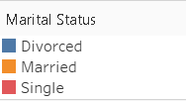
Marital Status
Martial Status stores the current marital status of our policyholders.
They are classified into Divorced, Married and Single.
To understand its relation with CLV we try to look into the data based on the classification with the help of a pie-chart.
The pie-chart shows CLV distribution by Marital Status in percentage.
By looking into the data, it is evident that Married customers are buying more auto insurance and thus adding more value to company.

Slide 12
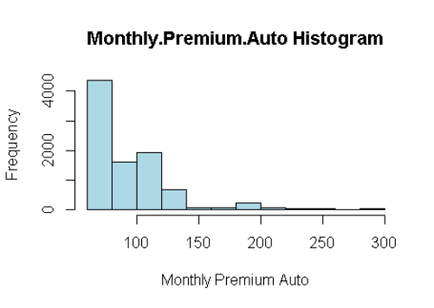
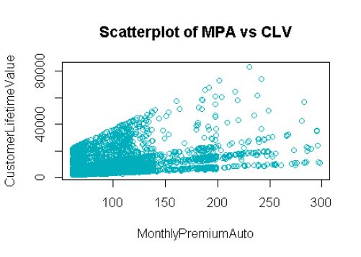
Monthly Premium Auto
Monthly Premium Auto stores the premium paid by the policyholders on a monthly basis.
For understanding with the help of a graphical representation, we draw a histogram and a scatter plot with respect to CLV.
Also, we find the skewness and the kurtosis value.
The Skewness is 2.123546. Thus MPA is positively skewed and most values are concentrated on the left. This can be said by looking at the histogram.
Kurtosis is 6.193605. Since it is >3, it is Leptokurtic.
There is presence of extreme values.
There is a Positive Correlation of 39.62 % of MPA with CLV.
From scatter plot, it is clearly visible that on MPA, CLV is also Increasing.

Slide 13
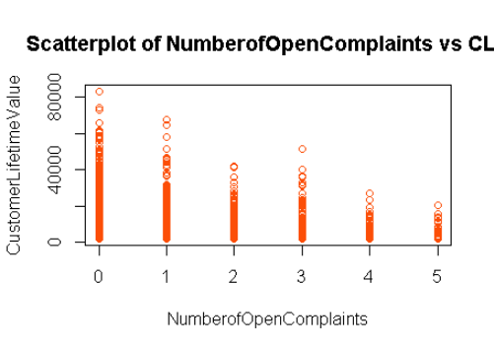
Number of Open Complaints
We find the correlation with the help of the scatter plot.
The variable has a negative correlation of -3.63%.
This is evident from the scatter plot that as umber of complaints increased, CLV decreased.
A negative, but closer to zero correlation shows that there is no strong relationship of this variable with CLV.

Slide 14
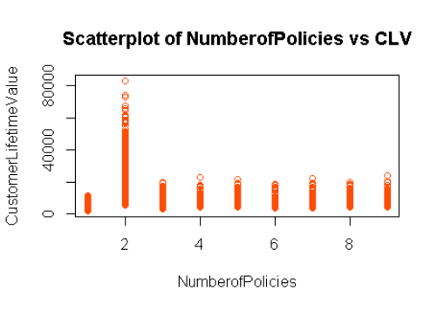
Number of Policies
This variable stores the total count of policies held by the customers.
We try to find the scatter plot to graphically understand the data.
Number of policies has a positive, but closer to zero correlation of 2.19% with CLV.
This suggests that there is no such strong relationship of this variable with respect to CLV.

Slide 15
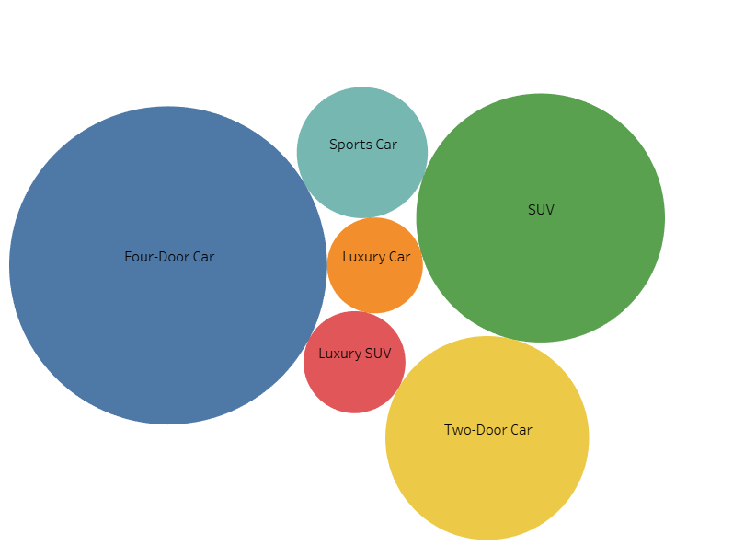
Vehicle Class
Vehicle Class variable stores the type of car held by the policyholders.
They are divided into 6 categories : Four door car, Two Door Car, SUV, Sports Car, Luxury car and Luxury SUV.
We use a bubble chart to graphically understand the data.
Customers having Four door cars and SUVs are more valuable and have a higher CLV.

Slide 16
Regression Results
We perform a Linear Regression on the model. First, we cap the extreme values present in our data with the help of quantile treatment. Then we split the data between Train and Test data and run individual regressions. We train our model on Train dataset and then run the same on our validation of test dataset. And finally we check on the popular assumptions. Here are our findings. :-
Multiple R-Squared : 0.9294
Adjusted R-Squared : 0.9287
Bp test p-value < 0.05
We use the Bp test to detect heteroscedasticity. We consider the null hypothesis that errors/residuals are homoscedastic, i.e. errors have constant variance. With the test result < 0.05 we reject the null hypothesis and conclude that the errors are heteroscedastic and does not have constant variance, which is not good for the model.
Dwt test statistic = 2.011192 and p-value >0.05
We use the dwt test to detect auto-correlation. Auto-correlation means there's correlation between the errors/residuals. As p-value is >0.05 we accept the null hypothesis that there is no Auto-correlation present.
ad test p-value < 0.05 and sf test p-value < 0.05
The Anderson-Darling test and Shapiro-Francia test are tests for normality, i.e. They test if the model has a normal or a near to normal distribution. In both cases, we consider the null hypothesis to be that the data is normal. As both tests give p-value < 0.05, we conclude that the data is not normally distributed.
MAPE value is 10.09% which means that the average error of the model is 10.09% which means the model is good.

Slide 17
Results Summary
With the given data after running the model, we are able to give the following explanations:
There are only a few policyholders with a high Customer Lifetime Value. Most of them have a low CLV.
The model has a negative intercept of -1086.82.
Customers who have taken Basic Insurance are more valuable than Extended/Premium policyholders.
Educated customers are more valuable than policyholders of other academic qualifications.
Employed customers are preferred.
Income hardly has an effect on the Customer Lifetime value.
Gender and Location has no role to play when it comes to determining the Customer Lifetime Value.
Married Customers are buying more policies and are thus more valuable to the company.
Sports and SUV car owners are more valuable for the company.
More no. of policies with a higher monthly premium amounts increases the CLV and are valuable.
While, more no. of open complaints decreases the CLV value.
Multicollinearity doesn’t exist in the model. That is, no more than two variables had a strong correlation between them.
About 92% of the data could be explained by the model. Which is good.

Slide 18
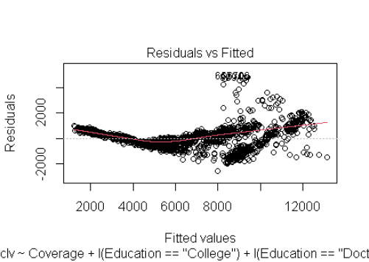
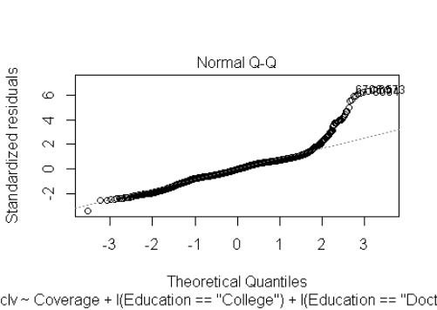
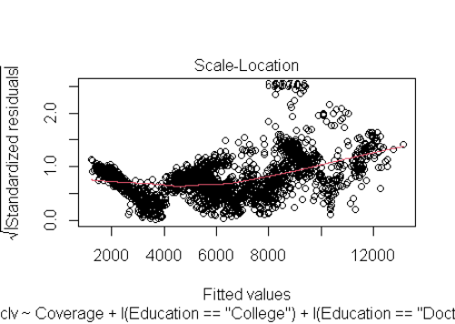
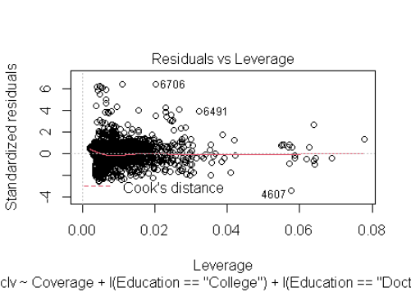
Graphical Representation of Actual vs Fitted
These 4 diagrams show the actual vs predicted values of the test data.

Slide 19
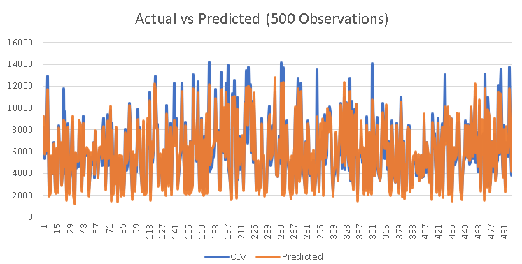
Actual vs Predicted Chart

Slide 20
Variable Relationships
We mention the variables and their respective relationship with our dependent/targeted variable.
The model takes form of a Linear Regression with variables having positive and negative coefficients.

Slide 21
Positive Variables
Number of Policies (2) : 6903.732
Number of Policies (3) : 3404.522
Number of Policies (4) : 3422.716
Number of Policies (5) : 3420.030
Number of Policies (6) : 3407.877
Number of Policies (7) : 3484.018
Number of Policies (8) : 3550.260
Number of Policies (9) : 3461.838
Vehicle Class (Sports Car) : 649.895
Vehicle Class ( SUV) : 735.304
Coverage (Extended) : 268.945
Coverage (Premium) : 601.364
Education (College) : 68.049
Education (Doctor) : 200.618
Education (Master) :151.537
Employment Status (Employed) : 168.897
Income : 0.003
Monthly Premium Auto : 44.787

Slide 22
Negative Variables
Employment Status (Unemployed) : -129.264
Marital Status (Single) : -155.790
Number of Open Complaints (3) : -368.984
Number of Open Complaints (4) : -474.736
Number of Open Complaints (5) : -341.138

Slide 23
Business Recommendation
This report represents my analysis for the Insurance company. It is my opinion that based on the data provided, targeting appropriate customers could increase the Customer Lifetime Value.
On a generalised scale, it is advisable to target customers who qualify for the variables that have a POSITIVE relationship with the target variable, as they have an increasing impact on the target variable of the firm. The factors that negatively impact the business of the company should be addressed and minimised as far as possible.
Thus keeping the benefit of the company in mind, there are a couple of recommendations.

Slide 24
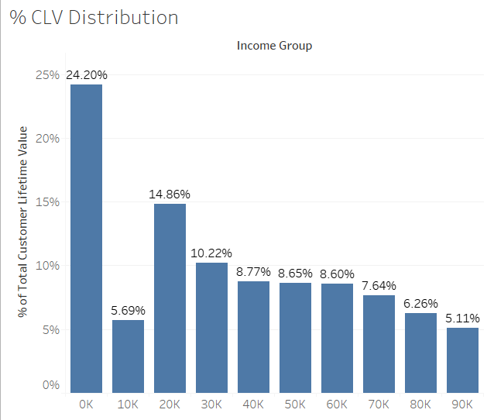
Focus on Basic Coverage
As explained by the diagram, majority customers are from low income groups. Hence, focus should be more on Basic coverage policy as they benefit the company more.

Slide 25
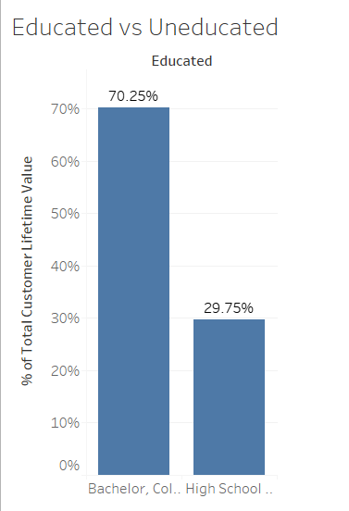
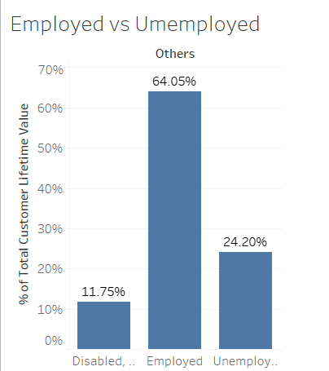
Educated Married & Employed
The company should focus more on customers that are educated married and employed and they are more valuable for the company.

Slide 26
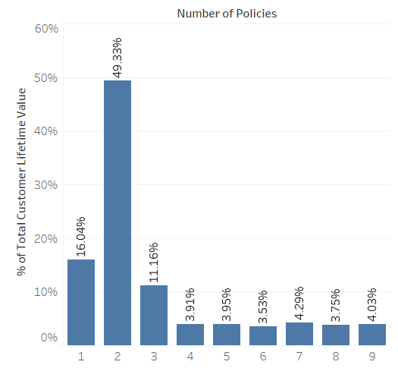
Monthly Premium and No. of Policies
Factors which are responsible for increasing the CLV are Monthly Premium and Number of Policies. Customers should be encouraged and incentivized to hold more than one policies as that would benefit the company.

Slide 27
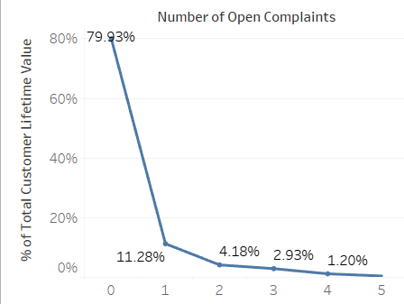
No. of Complaints decreases CLV
More number of Open Complaints will actually decrease customer lifetime value.
Thus, the company should put effort in resolving the complaints placed by the customers.

Slide 28

THANK YOU!
Abir
Chatterjee
Location, ID
Kolkata, 3391
Email
abirchatterjee17@gmail.com

